Slide 1

RUNGTA COLLEGE OF DENTAL SCIENCES & RESEARCH
DELEVOPMENTAL MILESTONES IN CHILDREN
DEPARTMENT OF PEDODONTICS AND PREVENTIVE DENTISTRY

Slide 2
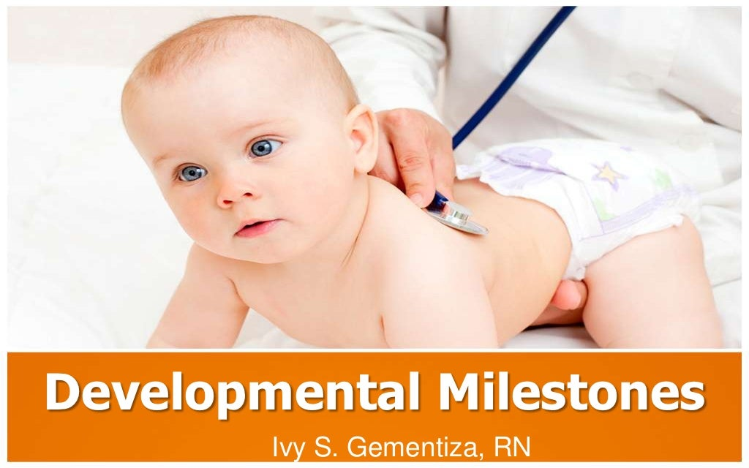

Slide 3
Specific learning Objectives
Core areas | Domain
Gross motor milestones Fine motor milestones | Language milestones Social milestones

Slide 4
CATEGORY
MUST TO KNOW
NICE TO KNOW
Language milestones
DESIRE TO KNOW
Emotional milestones
Gross motor milestones
Fine motor milestones
Social milestones
Developlmental red flags

Slide 5
CONTENTS
Introduction
Gross motor milestones
Language and social milestones
Emotional milestones
Developmental red flags
Test to assess developmental milestones

Slide 6
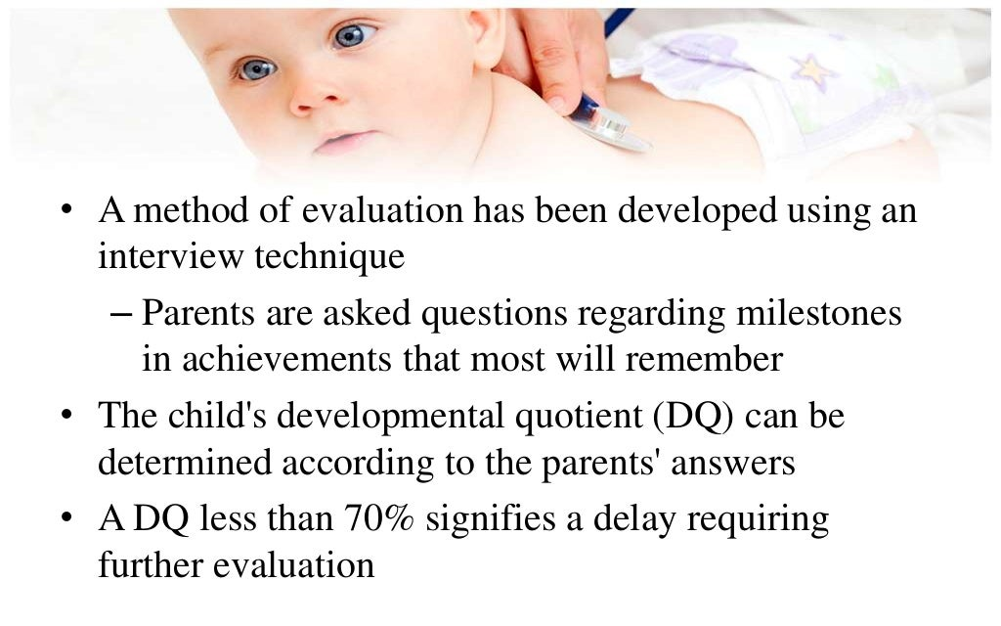

Slide 7


Slide 8
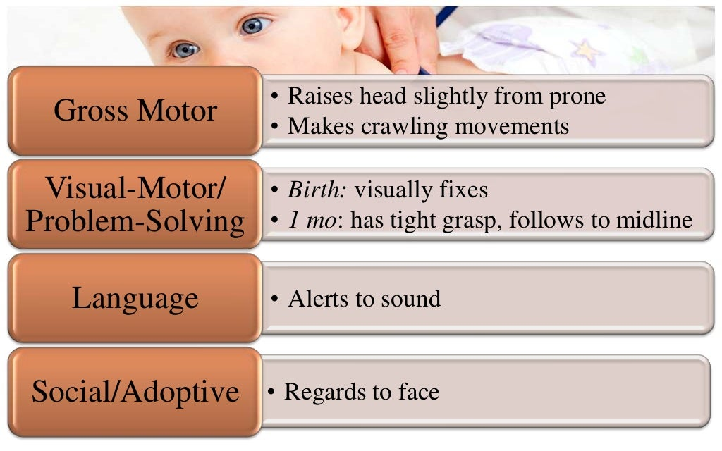

Slide 9
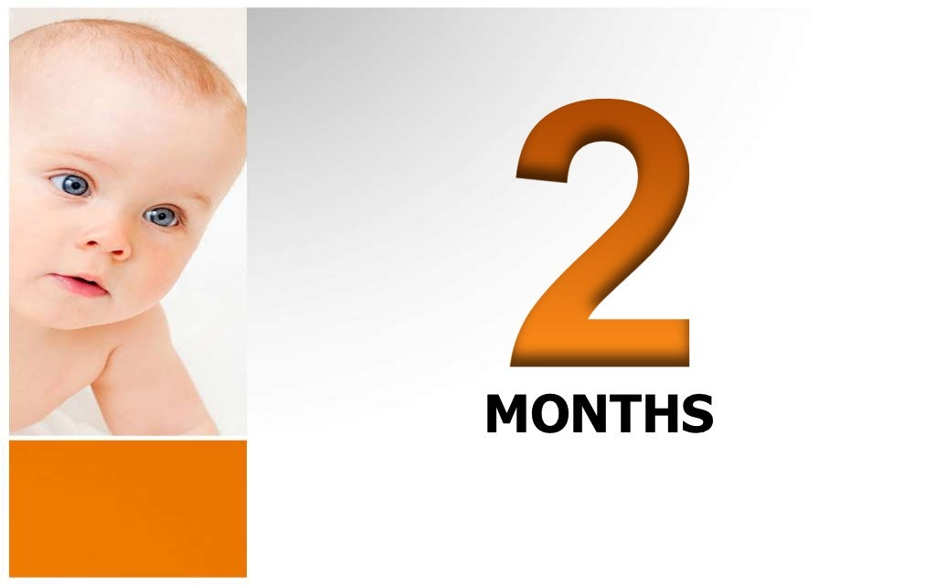

Slide 10
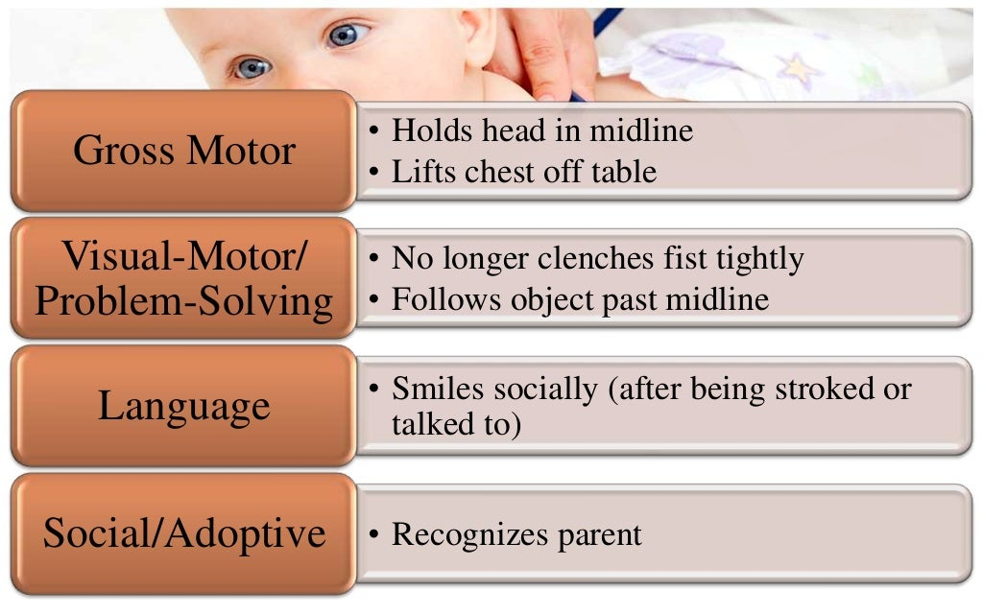

Slide 11
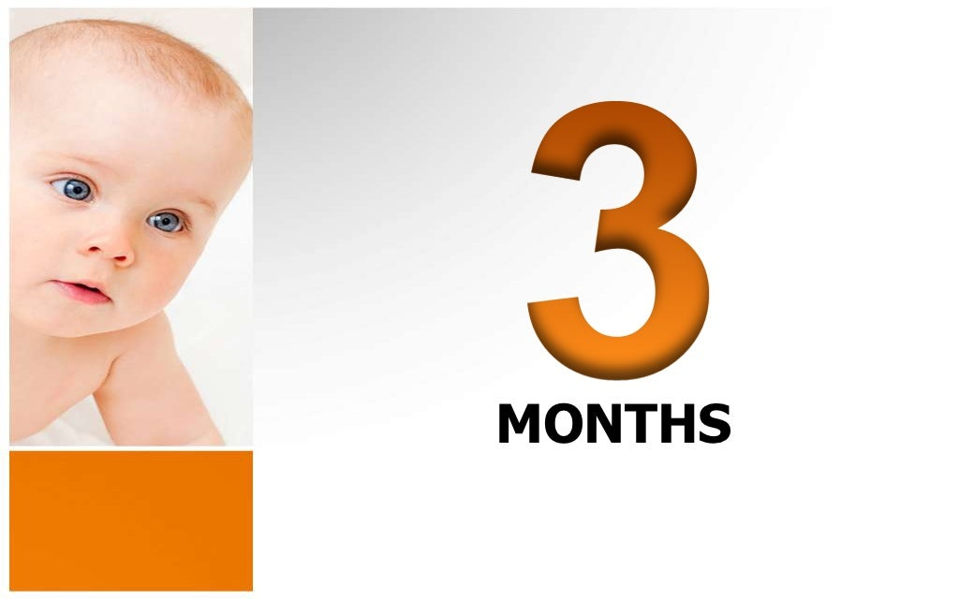

Slide 12
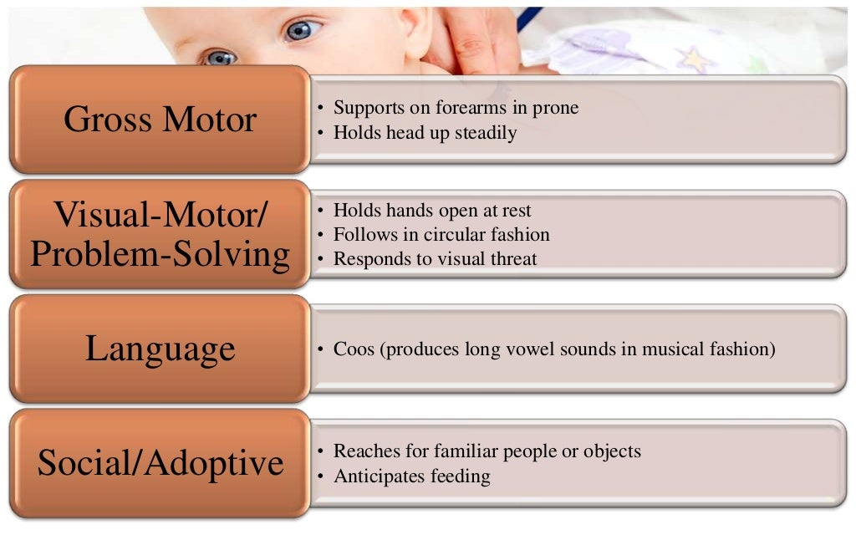

Slide 13
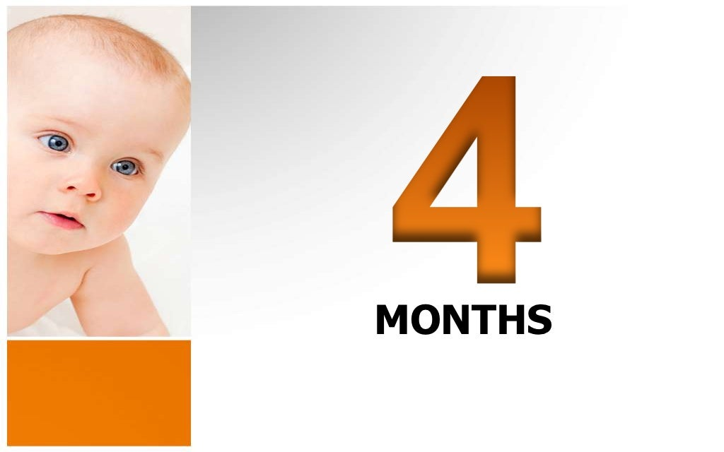

Slide 14
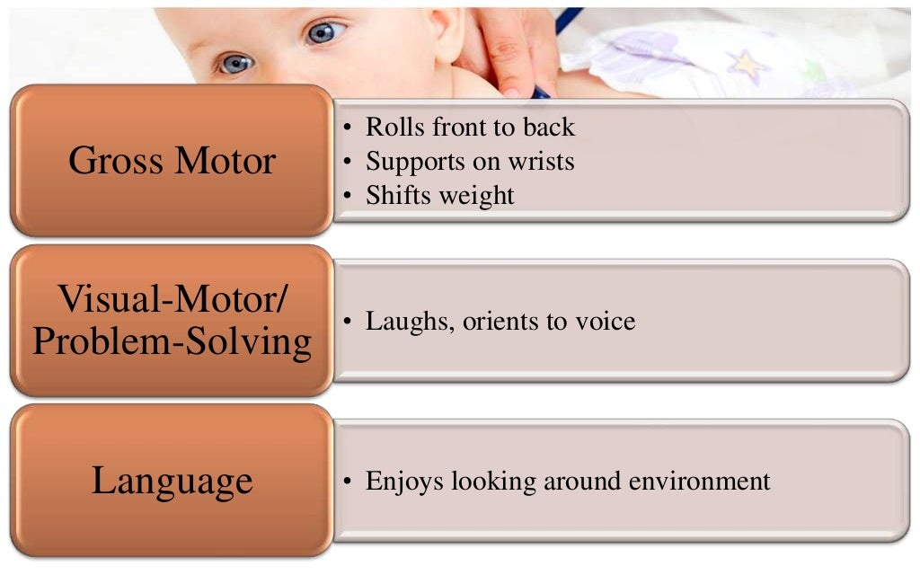

Slide 15
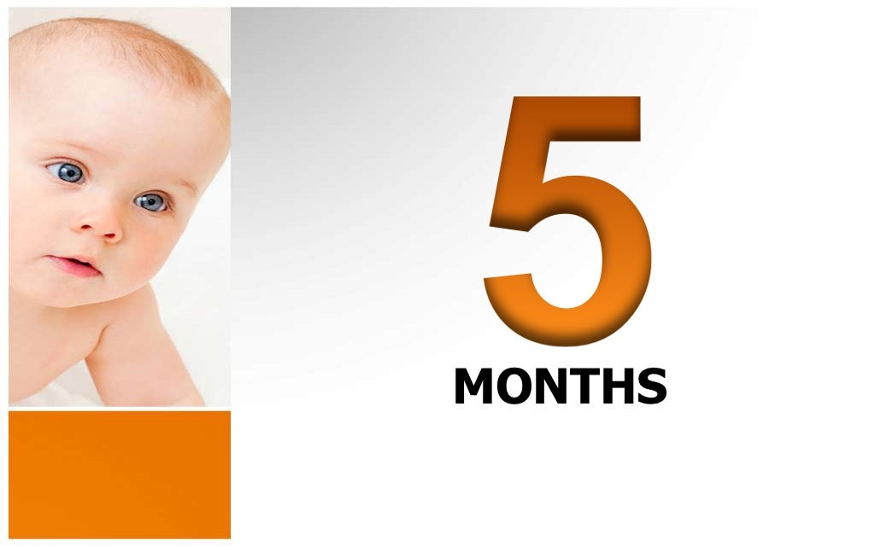

Slide 16
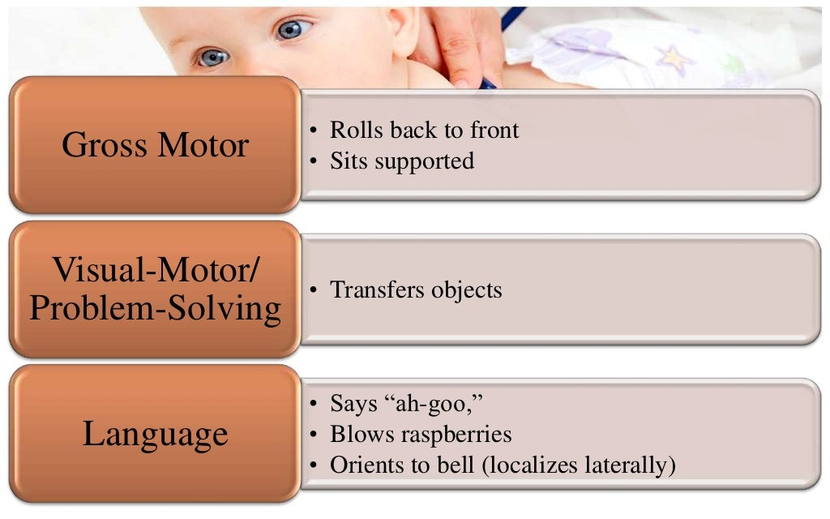

Slide 17
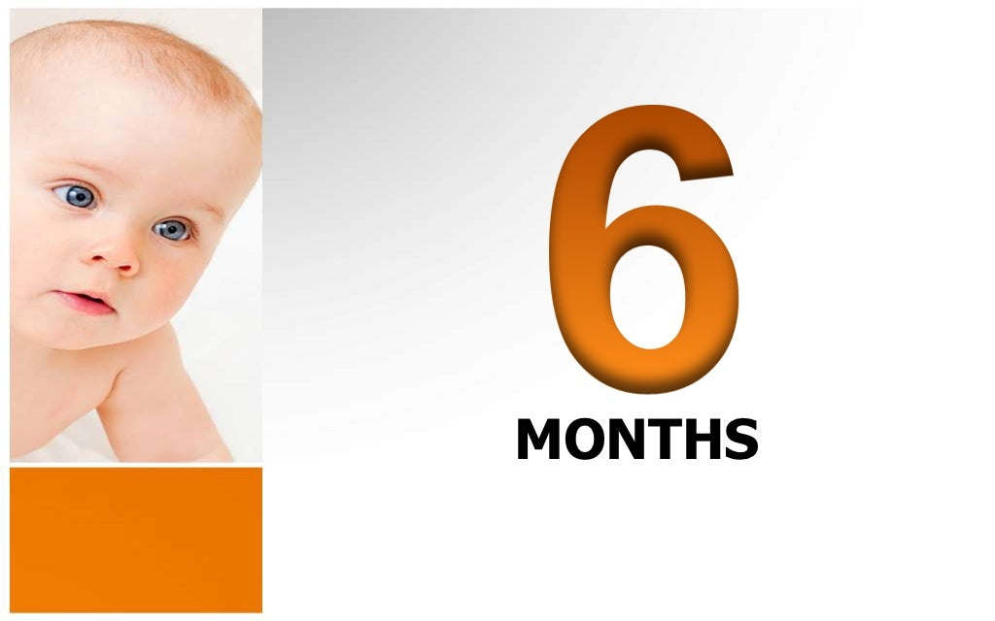

Slide 18
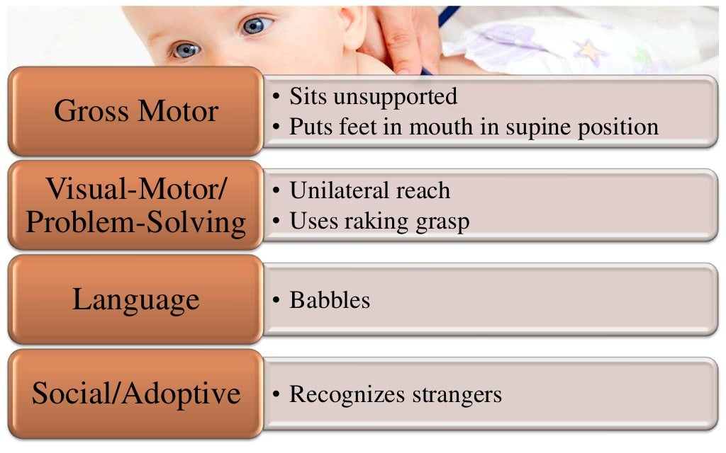

Slide 19
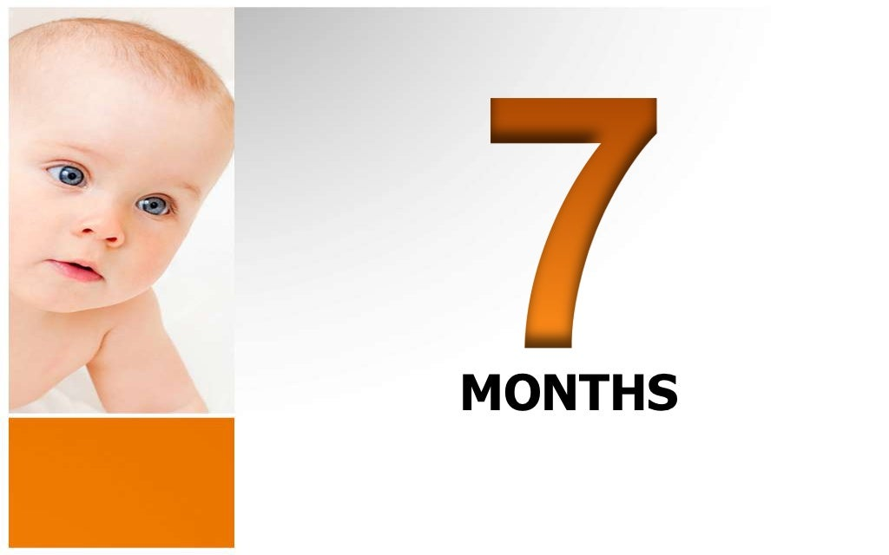

Slide 20
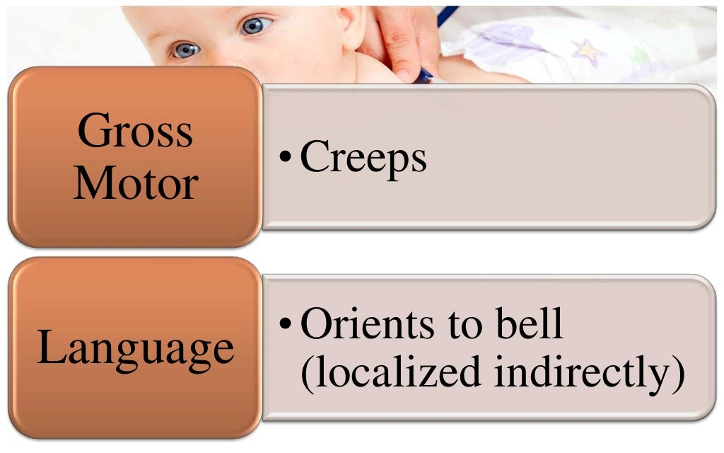

Slide 21
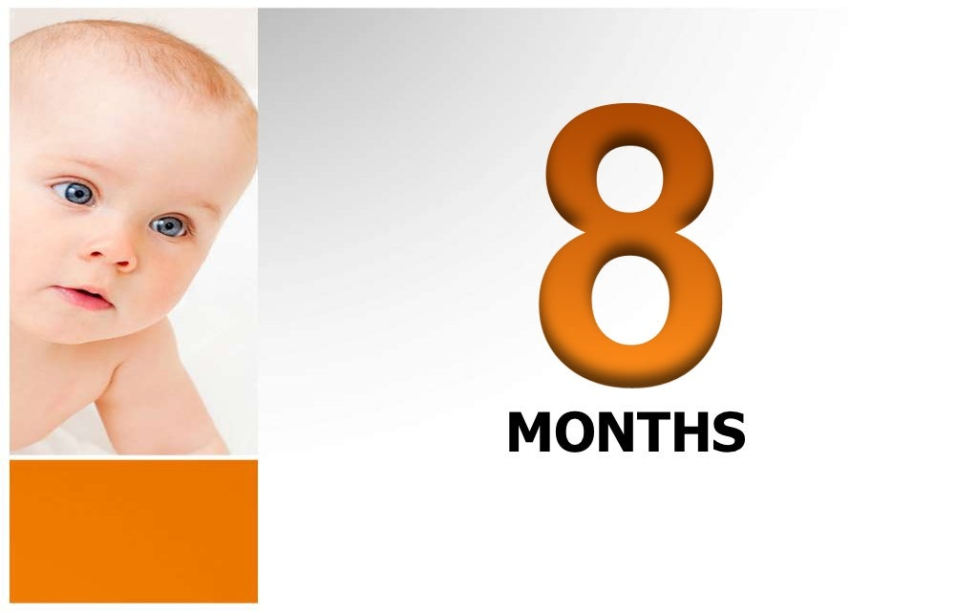

Slide 22
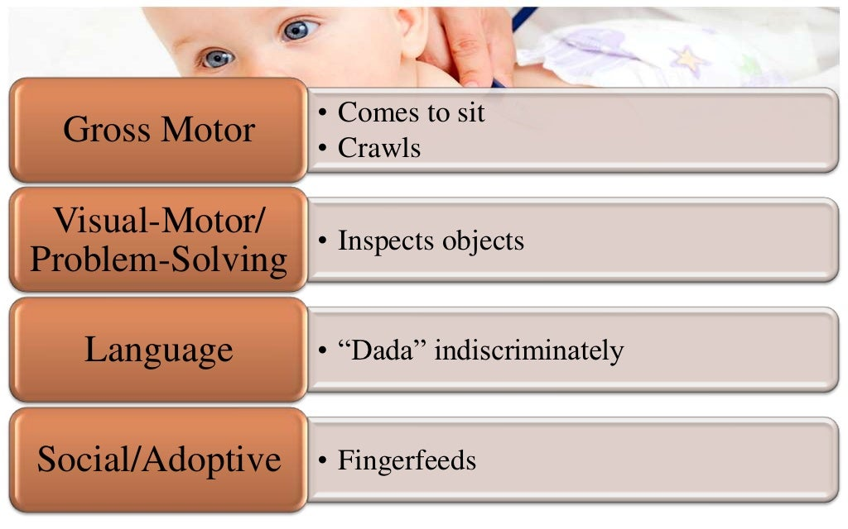

Slide 23
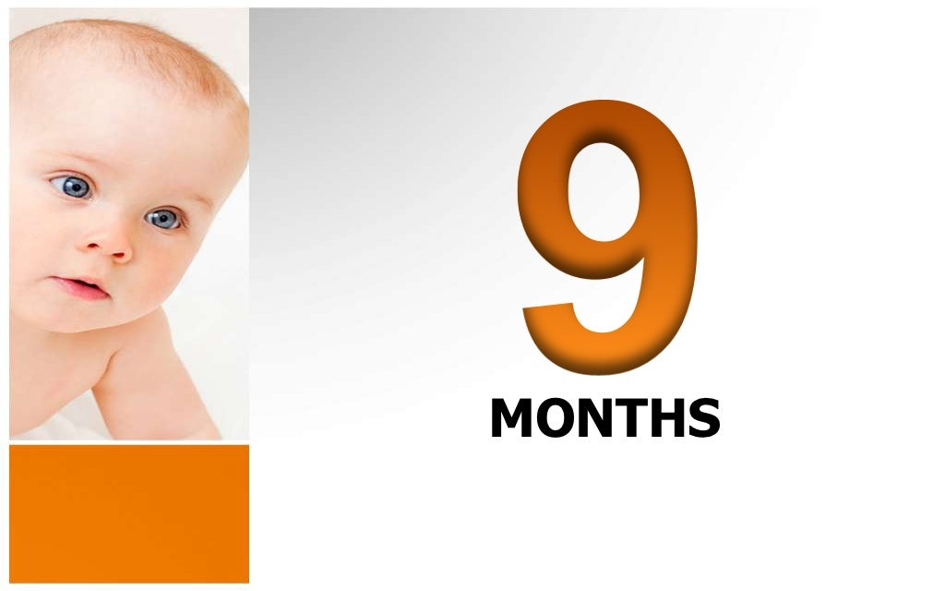

Slide 24
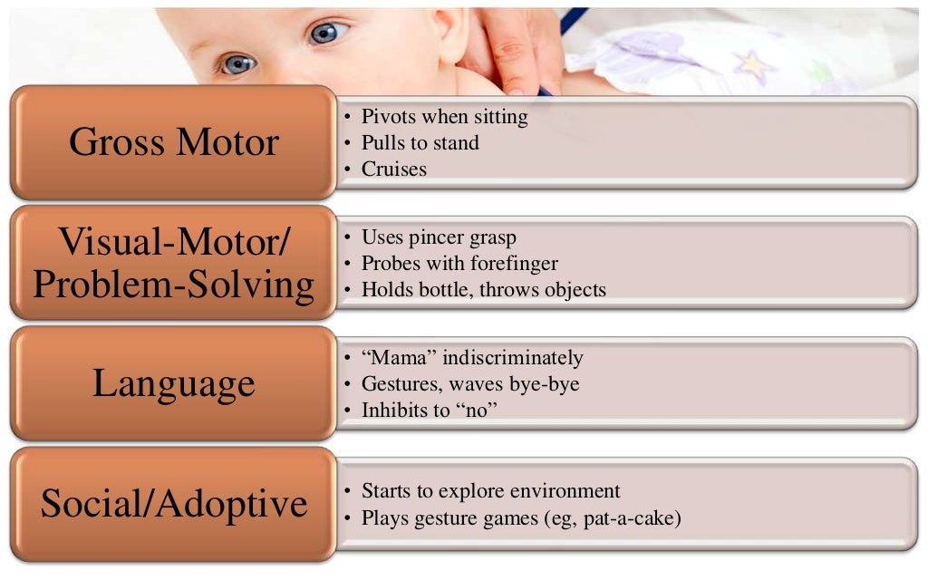

Slide 25
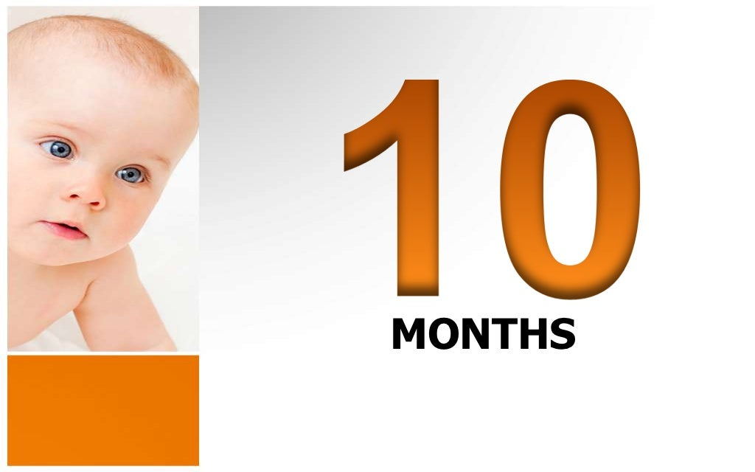

Slide 26
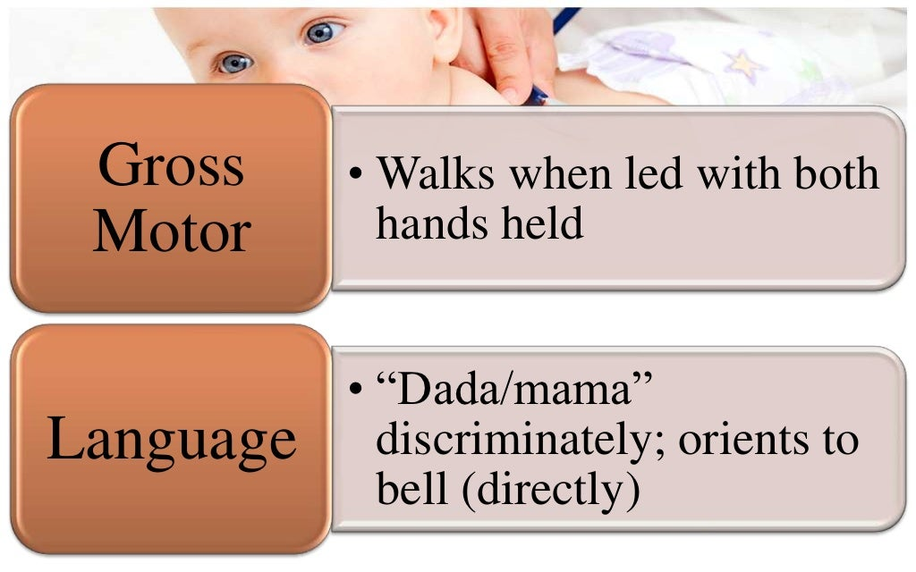

Slide 27
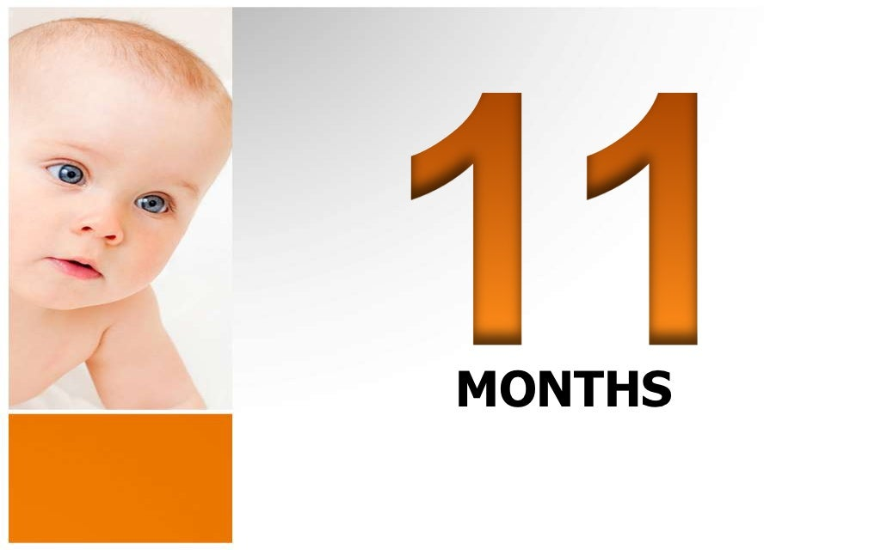

Slide 28
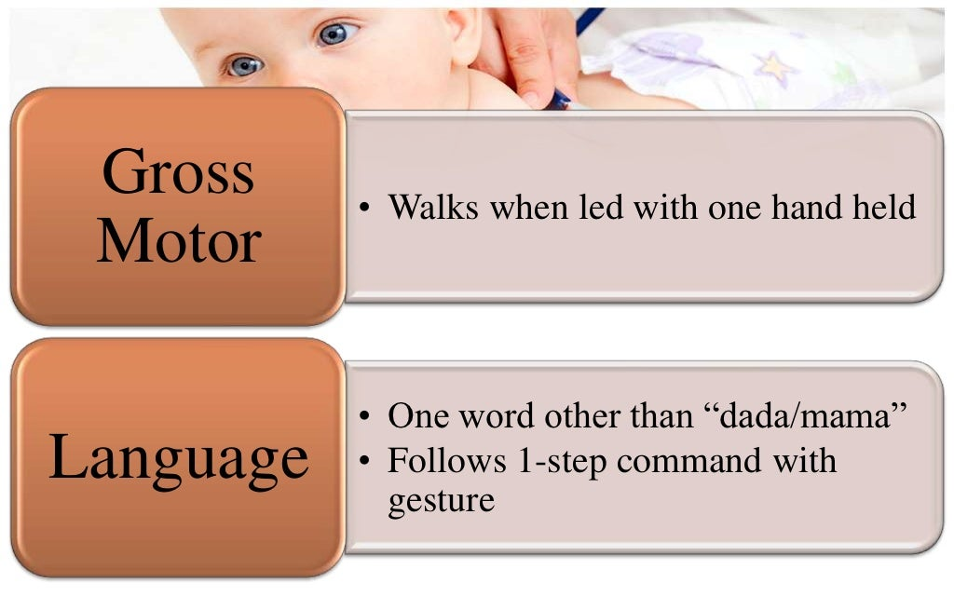

Slide 29


Slide 30
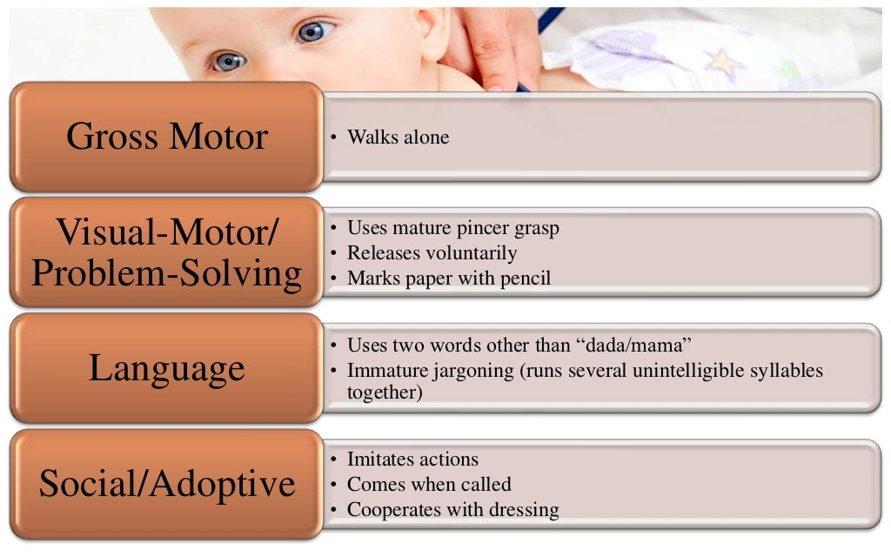

Slide 31
TAKE AWAY HOME MESSAGE
Developmental milestones provide a valuable
framework with the pediatrician can appropriately evaluate and observe children over time.
Skills developed in a cephalic – to – caudal
progression and from proximal to diatal.
Skills also progress from generalised responses
stimuli [primitive reflexes] to goal – oriented ,purposeful actions with ever –increase in precision and dexterity.

Slide 32


